Slide 1

Data Structures and Analysis (COMP 410)
David Stotts
Computer Science Department
UNC Chapel Hill

Slide 2
Abstract Data Types
(ADTs)

Slide 3
Abstract Data Types (ADT)
This segment will cover how to define the
Behavior
of a data structure without being bogged down in the details of an
Implementation
of the operations

Slide 4
ADT is a definition
One ADT definition
will be correct for
Many implementations
Define the behavior once, then
it guides implementation
it provides an oracle for determining correctness of the code

Slide 5
Abstraction
An abstraction is a “model” … a simplification of something complex
We take out some detail to show the basics of something in simple form
Details we remove are irrelevant to the aspects we wish to emphasize or explain in the model

Slide 6
Model of UNC
enroll
Do 4 or 5 times
Pay tuition
Take fall classes
Take spring classes
Get 1.7 mil emails from Alumni Assoc
graduate

Slide 7
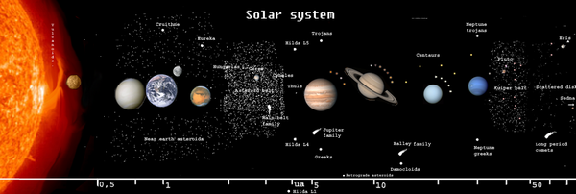
Model of the Solar System
What can we study here?
What can we not study?

Slide 8
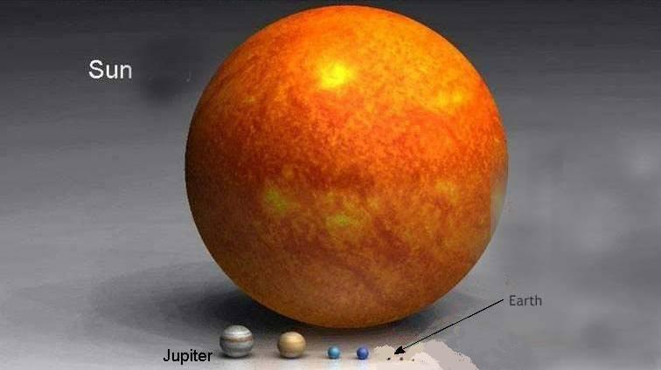
Model of the Solar System

Slide 9
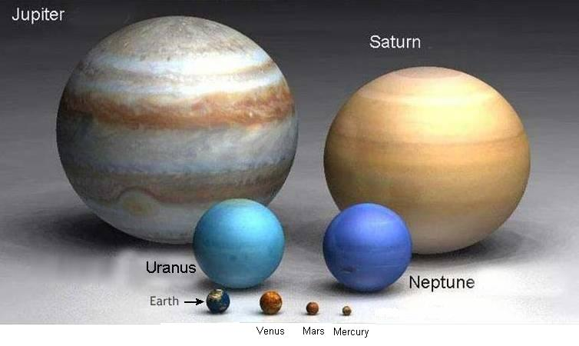
Model of the Solar System

Slide 10
Scale Model of the Solar System
Scale = 1:14,000,000,000
planet | scale size | perihelion | aphelion
The Sun | 10cm diameter 40 watt bulb | 0 | 0
Mercury | 1/3mm paint drop | 10 3/4 feet | 16 1/4 feet
Venus | 1mm paint drop | 25 feet | 25 1/2 feet
Earth | 1mm paint drop | 34 1/2 feet | 35 2/3 feet
Mars | 1/2mm paint drop | 48 feet | 59 feet
Jupiter | 10mm white marble or bead | 173 feet | 191 feet
Saturn | 8 1/2mm hatpin or pearl | 316 feet | 353 feet
Uranus | 3 1/3mm map pin or pearl | 642 feet | 705 feet
Neptune | 3 1/5mm map pin or pearl | 1045 feet | 1063 feet
I miss Pluto … don’t you?

Slide 11
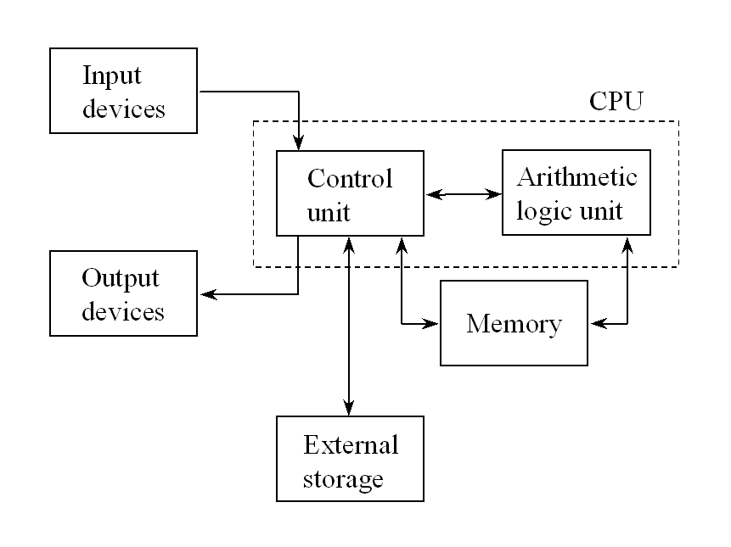
Von Nuemann Model of a Computer

Slide 12
Von Nuemann Model of a Computer

Slide 13
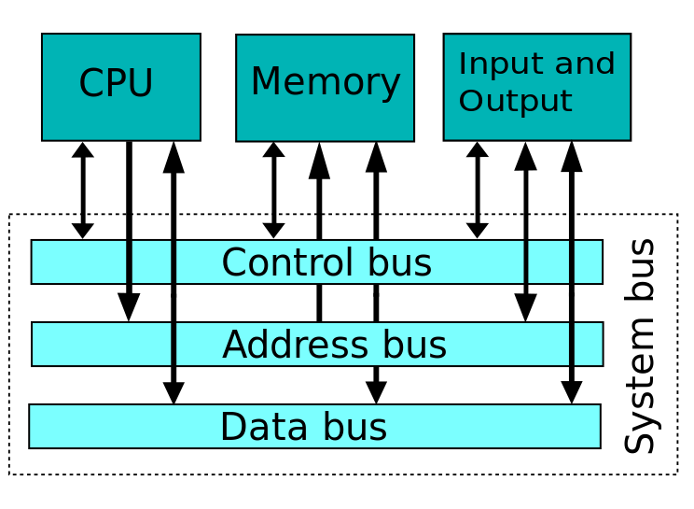
Von Nuemann Model of a Computer COMP 411 style

Slide 14
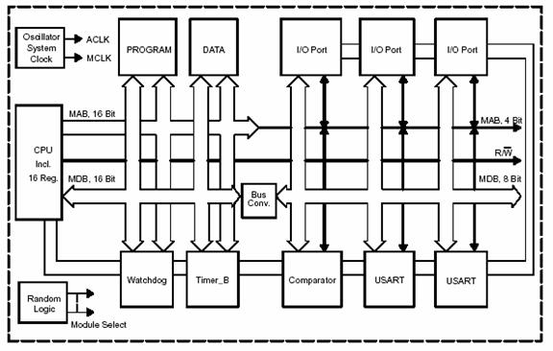
Von Nuemann Model of a Computer super COMP 411 style

Slide 15
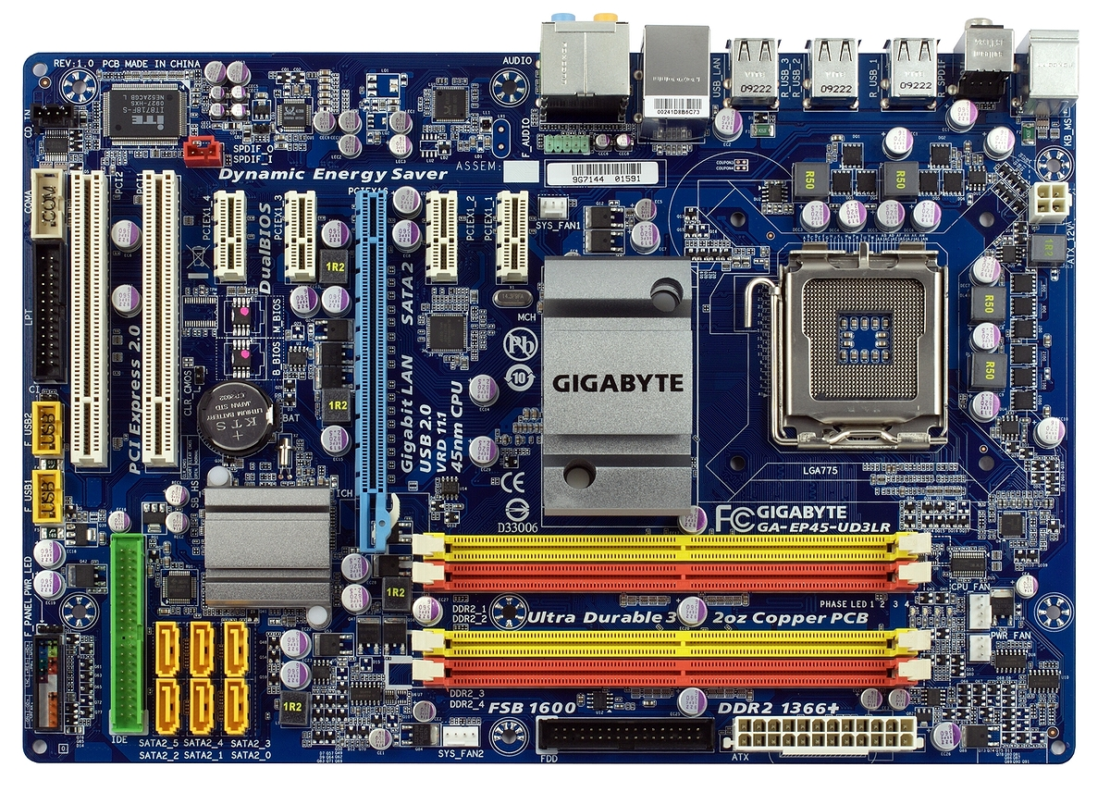
Network,
cloud
USB
Disk drives, DVD
CPU
regs
cache
Main memory
RAM

Slide 16
How can Data be Abstract?
We think of a data structure as being more that just data
We think of it as data values together with behavior… operations that manipulate the data values
So for every operation we want to define a function that will transform its arguments into its return values

Slide 17
How can Data be Abstract?
We want a model …
Left out:
details related to implementation in any particular programming language
Left in:
changes made to state of the data (the values and their relationships) when various operations are performed

Slide 18
Specifying (Defining) an ADT
First develop the functional signature
list of all operations, the types of the arguments to them, and the types of the results
Next provide an axiomatic specification of the behavior of each operation (method)
Today we will use a math notion to get used to the idea of specifying ADTs
Next time we will use ML (and get executable specifications)

Slide 19
Guttag’s Method
Use a functional notation to define functions (no surprise there)
We think of ADTs as a model for objects in programs, so there is a slight mismatch…
Function takes input and produces output, like a black box… no state remains
Object has persistent state and a method call alters that state

Slide 20
Stack
LIFO last in first out
new()
push(73)
Push(8)
Push(-61)
Push(12)
top
12
-61
size is 4
8
73

Slide 21
Stack
pop( )
12
top
-61
top
-61
8
8
size is 3
73
73

Slide 22
Using a Stack Object
var stk = New STACK( );
print( stk.size( ) );
stk.push(73);
stk.push(8);
stk.push(-61);
stk.push(12);
print(stk.size( ) );
stk.pop( );
print( stk.size( ) );
print( stk.top( ) );

Slide 23
Functional view
stk = new ( );
print ( size ( stk ) );
stk = push(stk,73);
stk = push(stk,8);
stk = push(stk,-61);
stk = push(stk,12);
print(size(stk));
stk = pop(stk);
print(size(stk));
print(top(stk));

Slide 24
Example: STACK of Int
Signature
new: → STACK
push: STACK x Int → STACK
pop: STACK → STACK
top: STACK → Int
size: STACK → Nat (natural number)

Slide 25
Example: STACK of Int
Axioms for Behavior
Idea is to write an equation (axiom) giving two equivalent forms of the data structure
Ex: size( new() ) = 0
Ex: size( push( new(), 6 ) ) = 1
Ex: top ( push ( push ( new(), 3 ), -8 ) ) = -8
Ex: pop ( push ( new(), -3 ) ) = new()
Ex: top(pop(push(push(new(),2),7))) = 2
Will this end?
How can we capture all possible behavior?

Slide 26
Back to Guttag
Follow this procedure to generate set of axioms that are finite and complete
Find canonical operations
Make all LHS for axioms by applying each non-canonical op to a canonical op (cross product)
Use your brain and create an equivalent RHS for each LHS

Slide 27
Back to STACK of Int
A canonical operation is one that is needed if your goal is to generate ALL possible stack values by calling successive operations
A non-canonical op is one that is not needed… in other words, all uses of it can be replaced by some use of others (canonicals).
Ex: push ( pop ( push ( new(), 6) ), 3)
is the same as
push ( new(), 3 )
the pop operation is not needed to create the
stack with a single element, the “3”

Slide 28
STACK (cont.)
STACK ops: new, push, pop, top, size
Canonicals: new, push
Note that all ops that return something other than STACK are non-canonical (top, size)
Canonicals are ops that construct values, and even so only the necessary ones
pop constructs… it returns a STACK
But we showed it can be successfully avoided with judicious use of new and push

Slide 29
STACK (cont.)
LHS of axioms (non-canon applied to canon)
size( new() ) = ?
size( push( S, i ) ) = ?
pop( new() ) = ?
pop( push( S, i )) = ?
top( new() ) = ?
top( push( S, i )) = ?

Slide 30
STACK (cont.)
LHS of axioms (non-canon applied to canon)
size( new( ) ) =
0
size( push( S, i ) ) =
size( S ) + 1
pop( new( ) ) =
new( )
pop( push( S, i )) =
S
top( new( ) ) =
err
top( push( S, i )) =
i

Slide 31
Notes
How do the axioms specify behavior like “when we pop a STACK the size goes down by one” ?
Think of STACK values as sequences of ops
push( pop( push( push(new(),6), 3 ) ), 4 )
Think of axioms as rules for rewriting these sequences into simpler form
pop(push(S,i)) = S
lets us rewrite by pattern matching parts of the sequence with variables in the axiom

Slide 32
Notes
Lets us rewrite by pattern matching parts of the sequence with variables in the axiom
STACK: push( pop( push( push(new(),6), 3 ) ), 4 )
AXIOM: pop( push( S, i ) ) = S
In the STACK value this part is S from the AXIOM
S matches push(new(),6)
Axiom rewrites the STACK as
push( push( new(), 6) , 4 ) size is 2
3 pushes in STACK value, but size is 2 when done

Slide 33
Notes
Why non-canonical applied to canonical?
Canonical op constructs (or extends) a STACK
Non-canonical op then measures it… tells us something about its state
“We just built a STACK by using push on some previous STACK.. what happens to the size? what item is now on top? “ etc.

Slide 34
QUEUE
FIFO first in, first out
new( )
add(4)
add(-31)
add(15)
size is 3
tail
front
4
31
15

Slide 35
QUEUE
front
tail
4
31
15
rem( )
front
tail
31
15
size is 2

Slide 36
Example: QUEUE of Int
Signature
new: → QUEUE
add: QUEUE x Int → QUEUE
rem: QUEUE → QUEUE
front: QUEUE → Int
size: QUEUE → Nat (natural number)
Canonical ops

Slide 37
QUEUE (cont.)
LHS of axioms (non-canon applied to canon)
size( new() ) = ?
size( add( Q, i ) ) = ?
rem( new() ) = ?
rem( add( Q, i )) = ?
front( new() ) = ?
front( add( Q, i )) = ?

Slide 38
QUEUE (cont.)
LHS of axioms (non-canon applied to canon)
size( new() ) = 0
size( add( Q, i ) ) = size(Q) + 1
front( new() ) = err
front( add( Q, i ) ) = ite( Q=new(), i, front(Q) )
rem( new() ) = new()
rem( add( Q, i ) ) =
ite( Q=new(), Q, add(rem(Q),i) )

Slide 39
Next time…
We will examine how to use ML to write these ADT specs
With ML we can then “execute” the specs and see if the behavior is what we like
Download and install ML on your computer and if you like you can begin to try ML…
See the ML notes on the class website

Slide 40
END

Slide 41
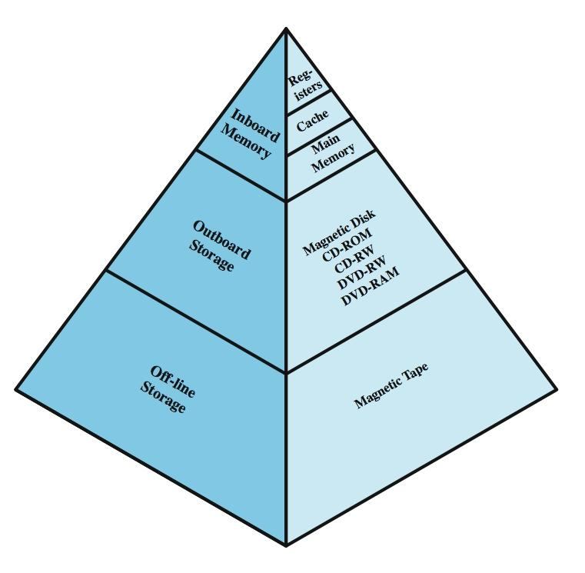
Memory Hierarchy
storage size increases
access time increases
cost decreases (per bit)
persistence increases
decreasing frequency of access by processor
The “cloud”

Slide 42
What happens when you power on your computer?
A minimum amount of information is read from secondary memory into main memory
Control is transferred to that area of main memory; this code reads the core of the OS, called the kernel
The kernel executes the initial process
This process loads a full OS off disk (or cloud)
Called bootstrapping (pulling oneself up by one’s bootstraps)… the computer “boots up”
OS then runs all the other programs you write and use… including JavaScript

Slide 43
Data output
wireless, usb, net, print port,
sound, video
User input
kernel
Keyboard
Mic
camera
Data to programs
Disk
Kernel talks to disk
CPU
CPU runs programs
kernel
CPU runs full OS
OS
OS loads
CPU runs kernel
Main memory
RAM

